Slide 1
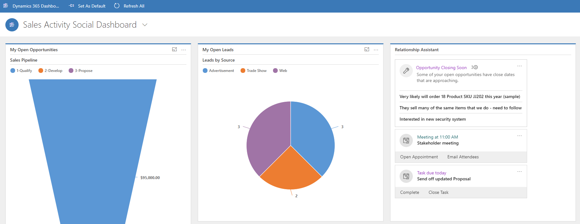
Assistance displays cards based on priority.
Actions such as opening the item, or executing a related item are offered as suggestions.

Slide 2
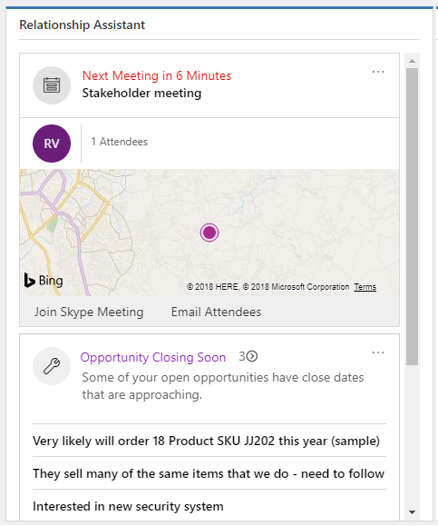
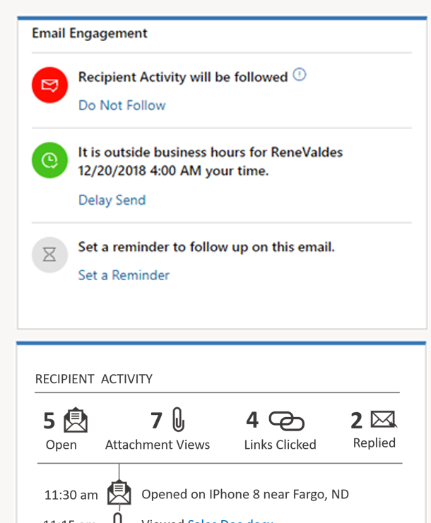
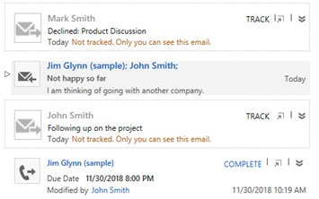
Relationship Assistant
Email Engagement
Auto Capture

Slide 3
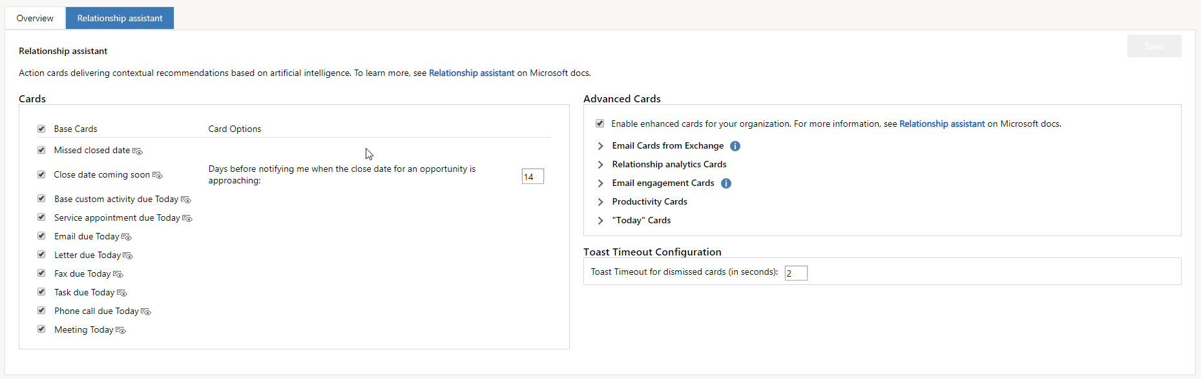
Base cards are enabled by default. Each option can be modified as needed.
Advanced cards are not enabled by default. They can be enabled to additional functionality.

Slide 4
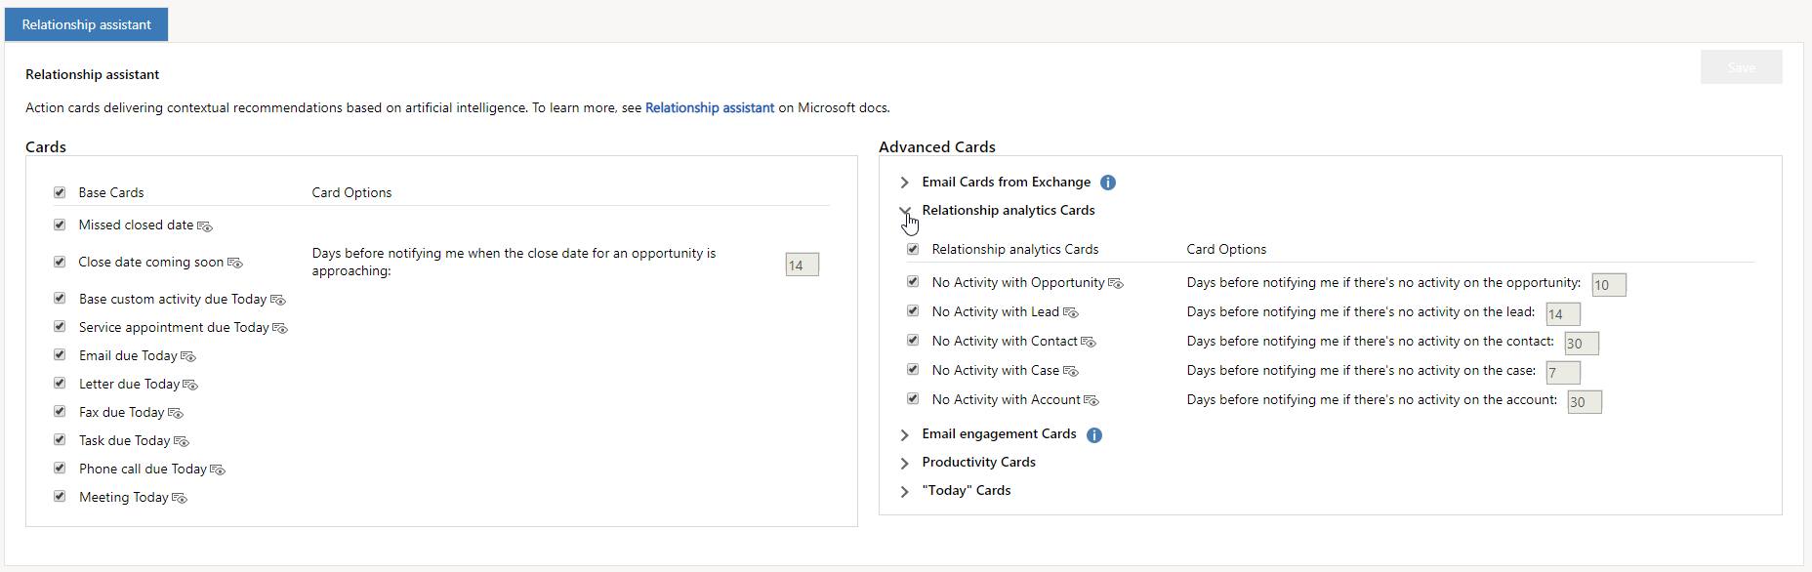
The number of days cannot be modified in personal settings.

Slide 5
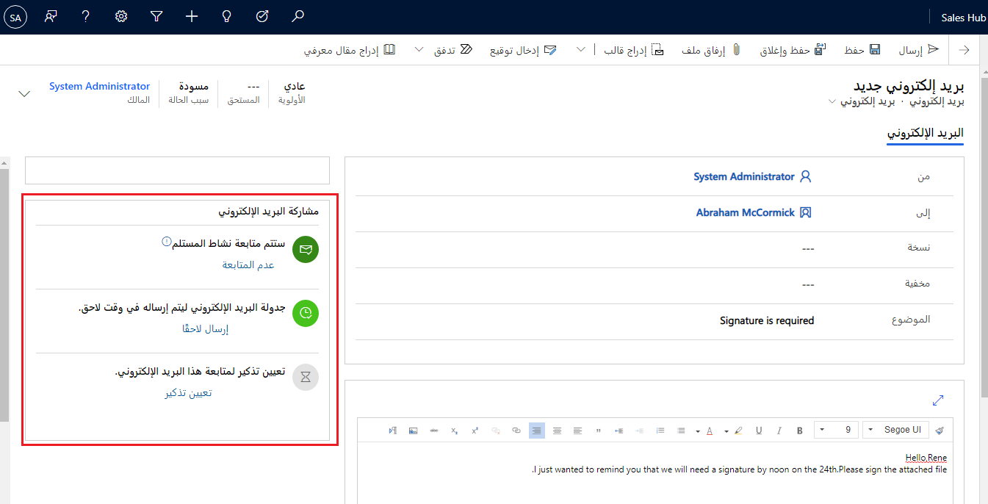
مشاركة البريد الإلكتروني.

Slide 6
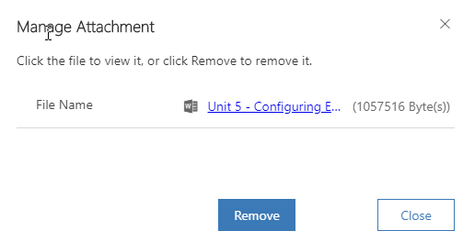
Choosing to follow attachment will upload the attachment to OneDrive for business as a link. Learn more
Follow

Slide 7
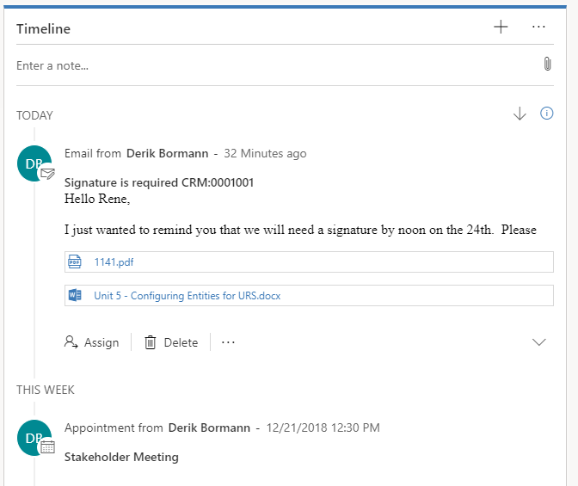

Slide 8
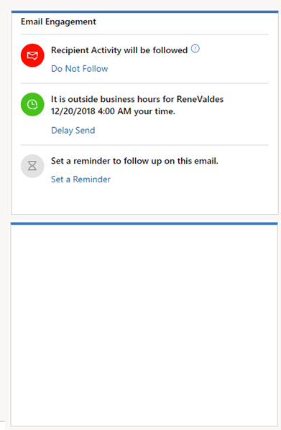
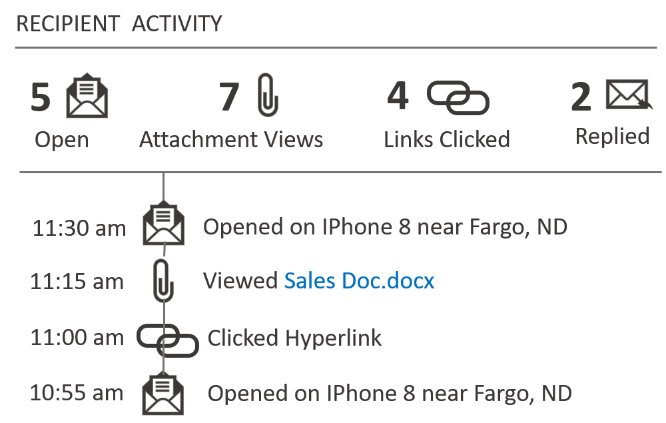
النشاط المعروض في نشاط البريد الكتروني.

